Slide 1
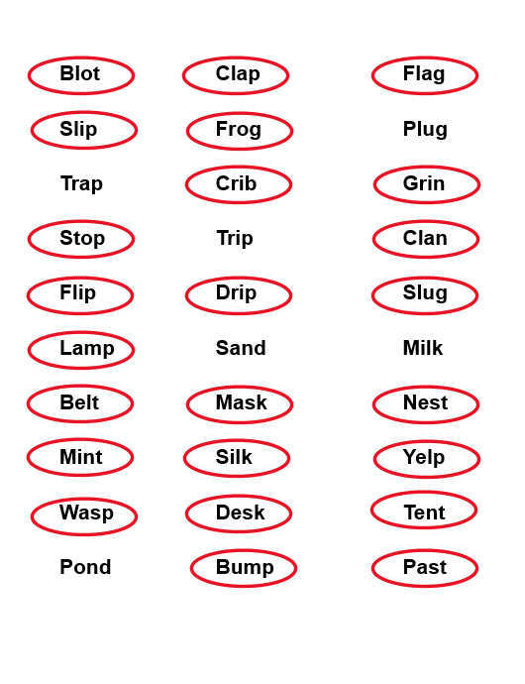
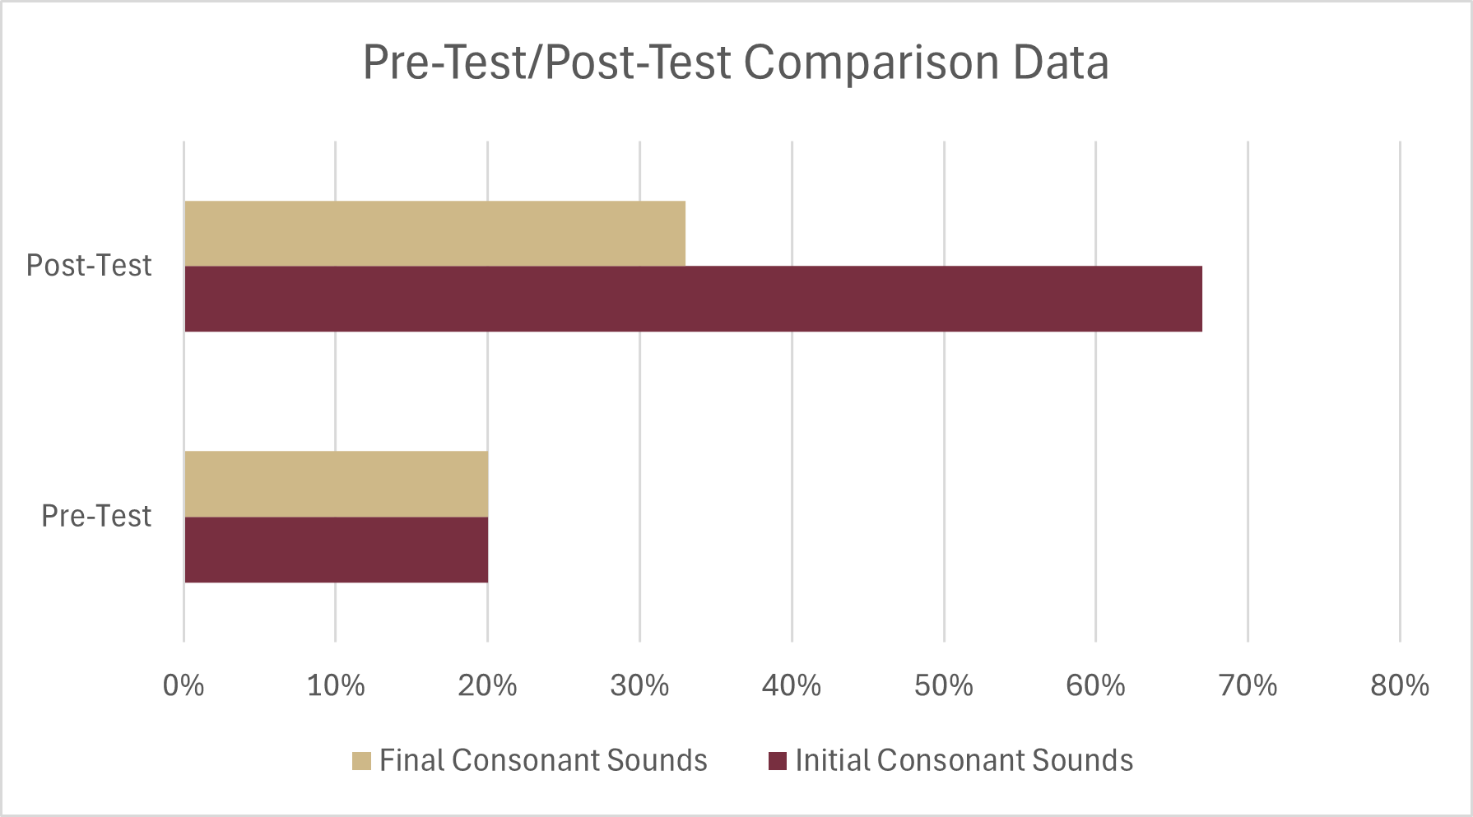
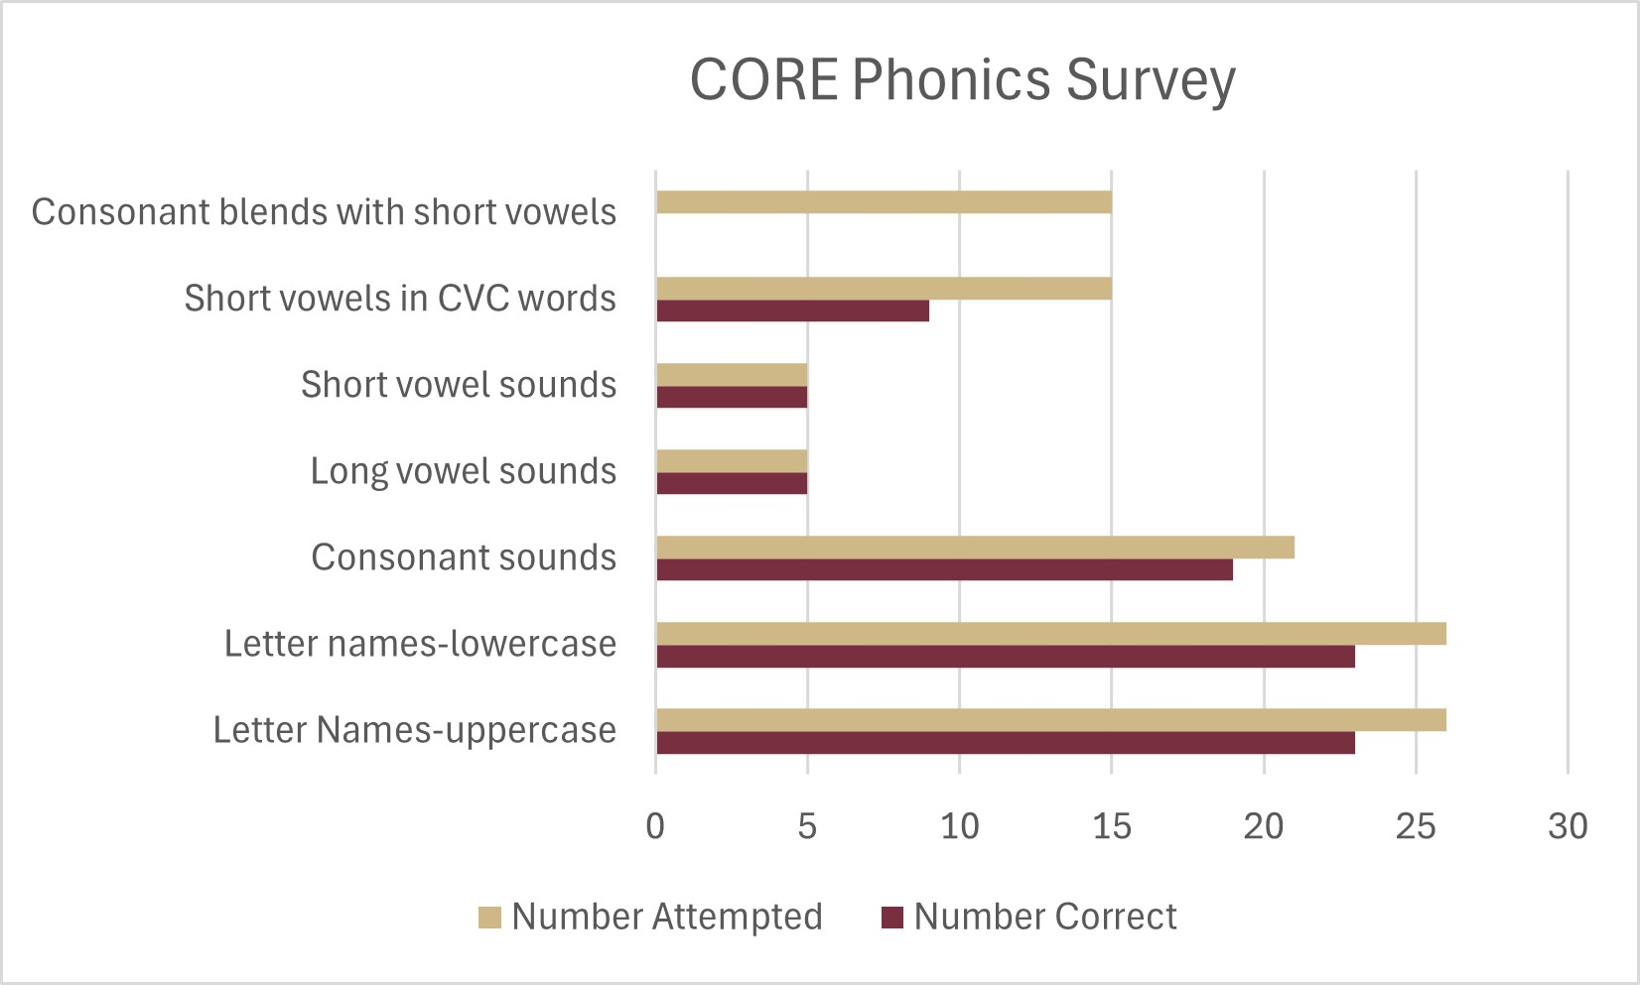
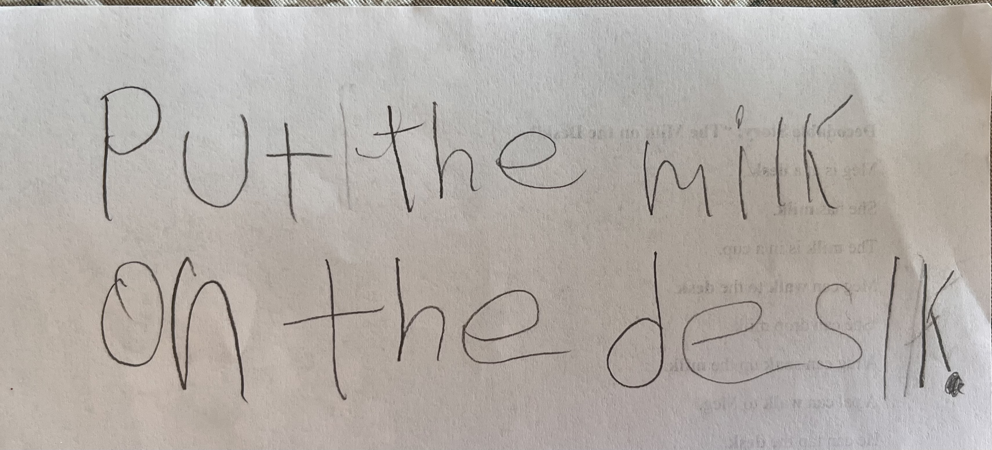
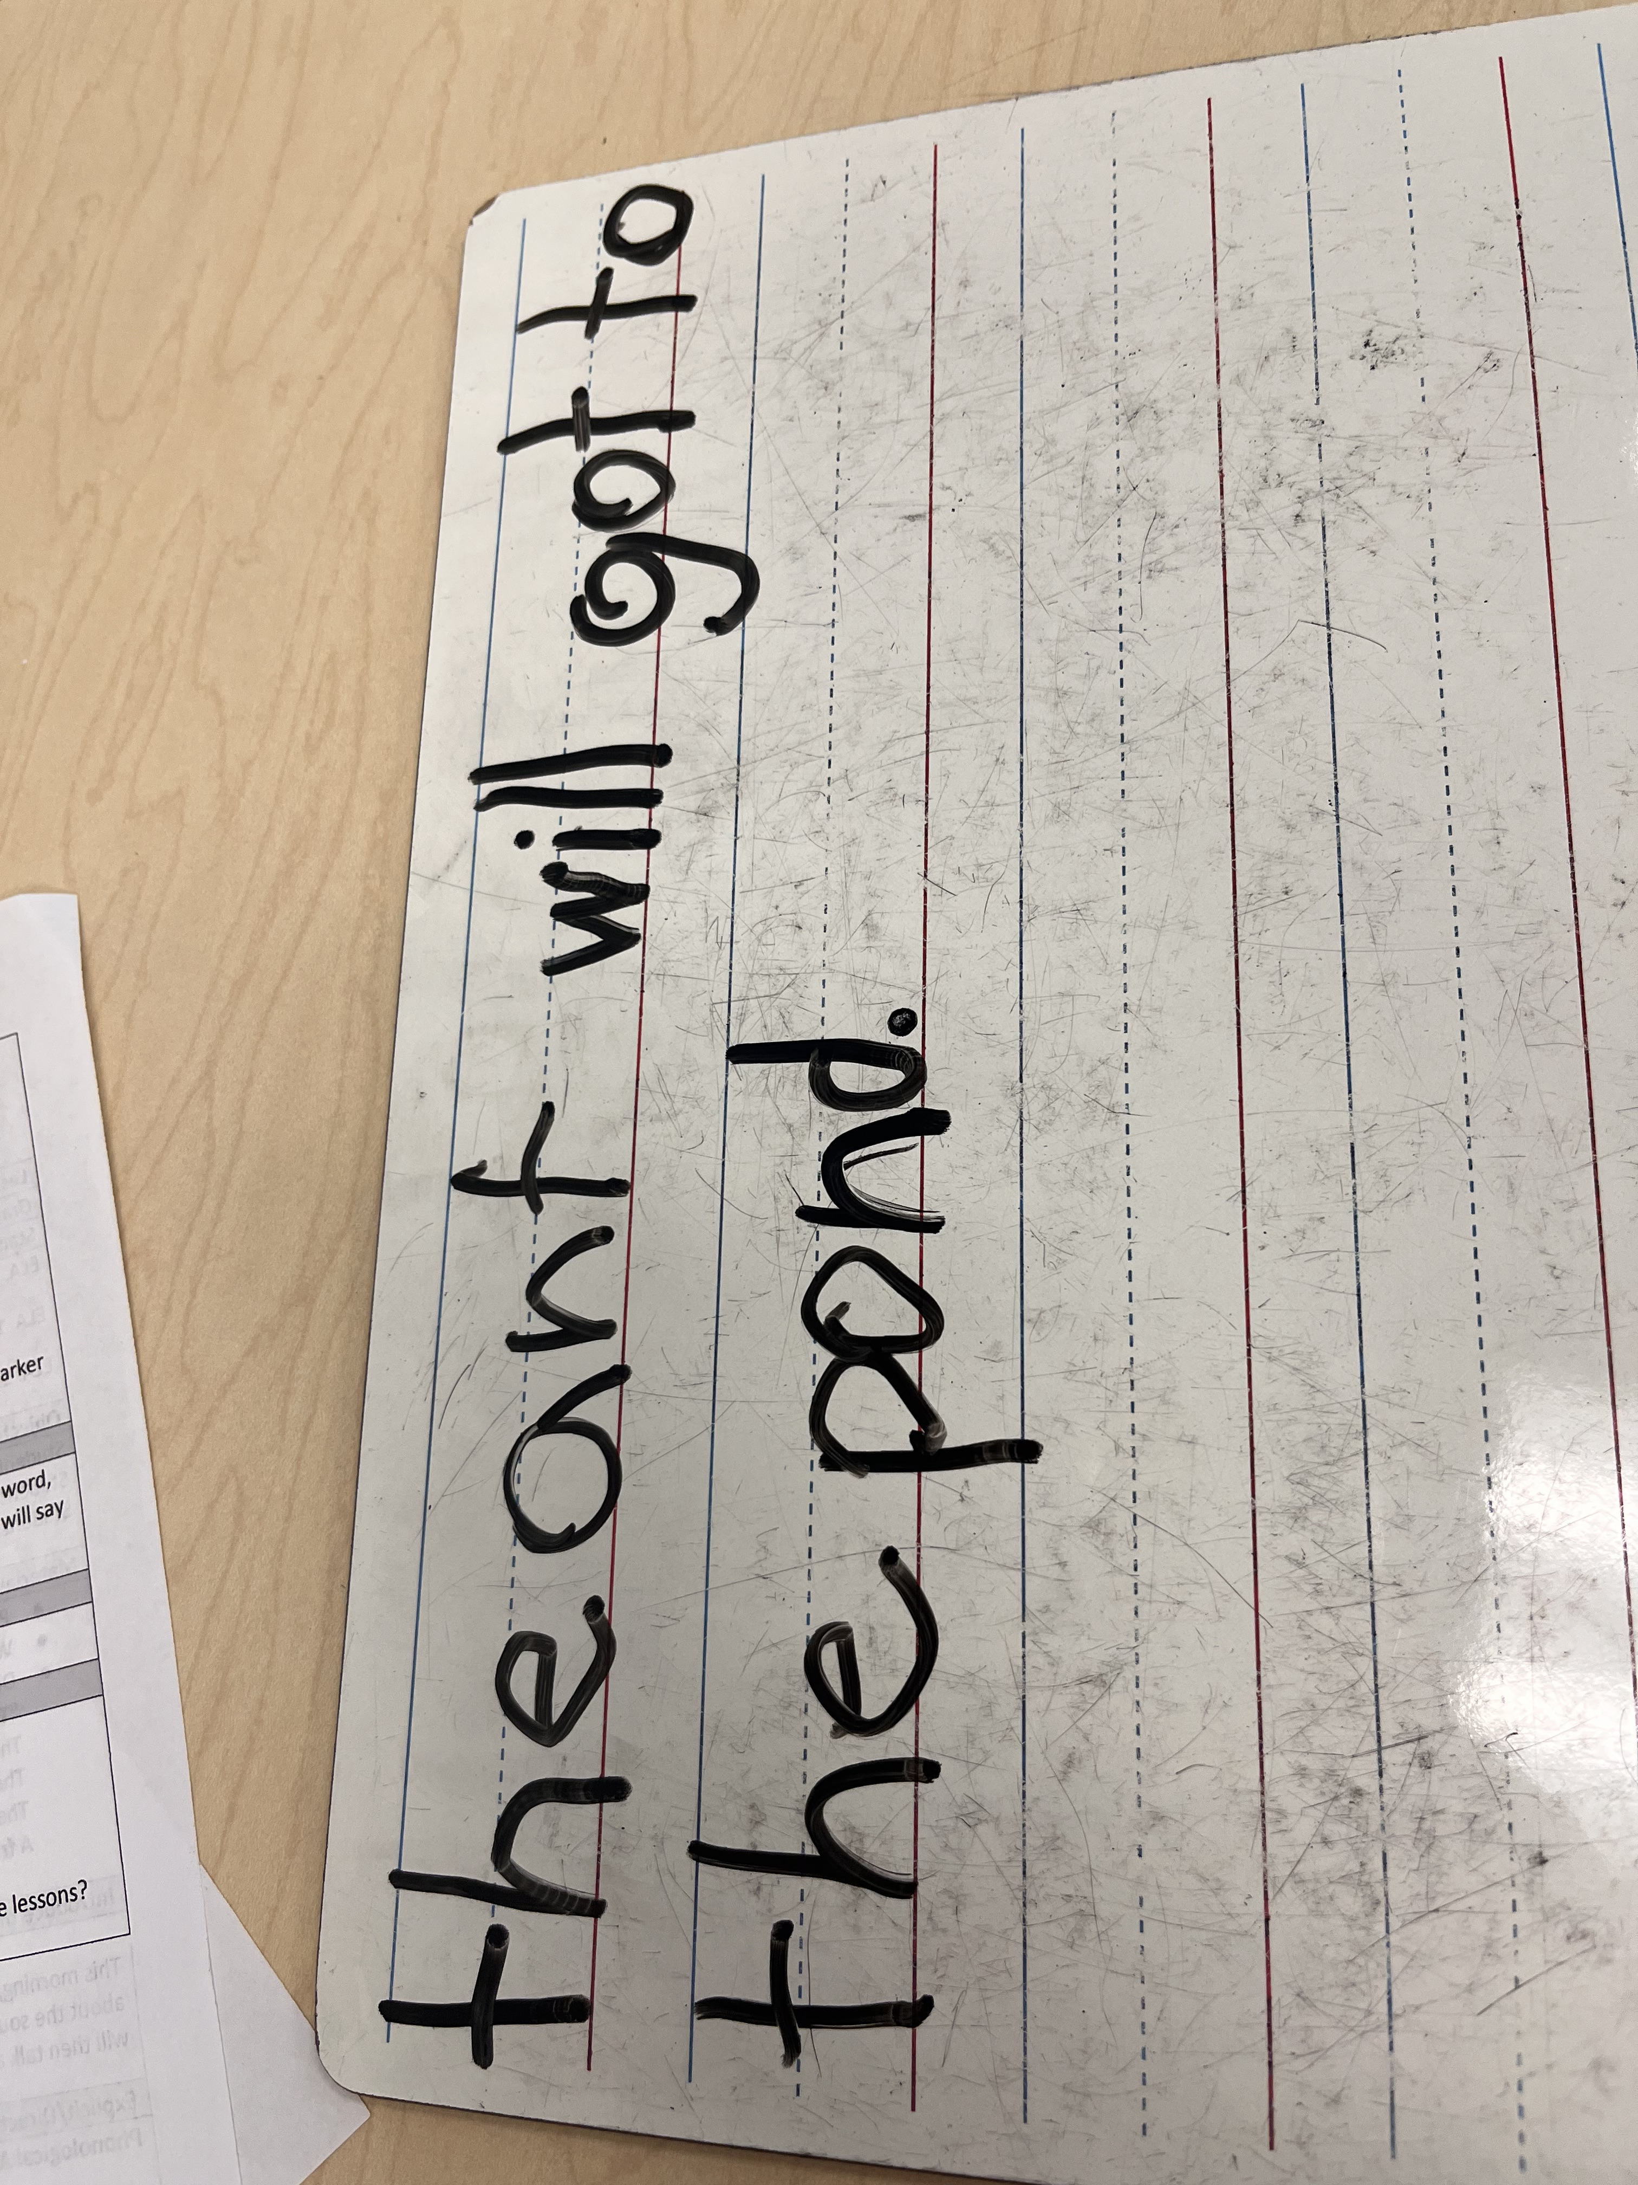
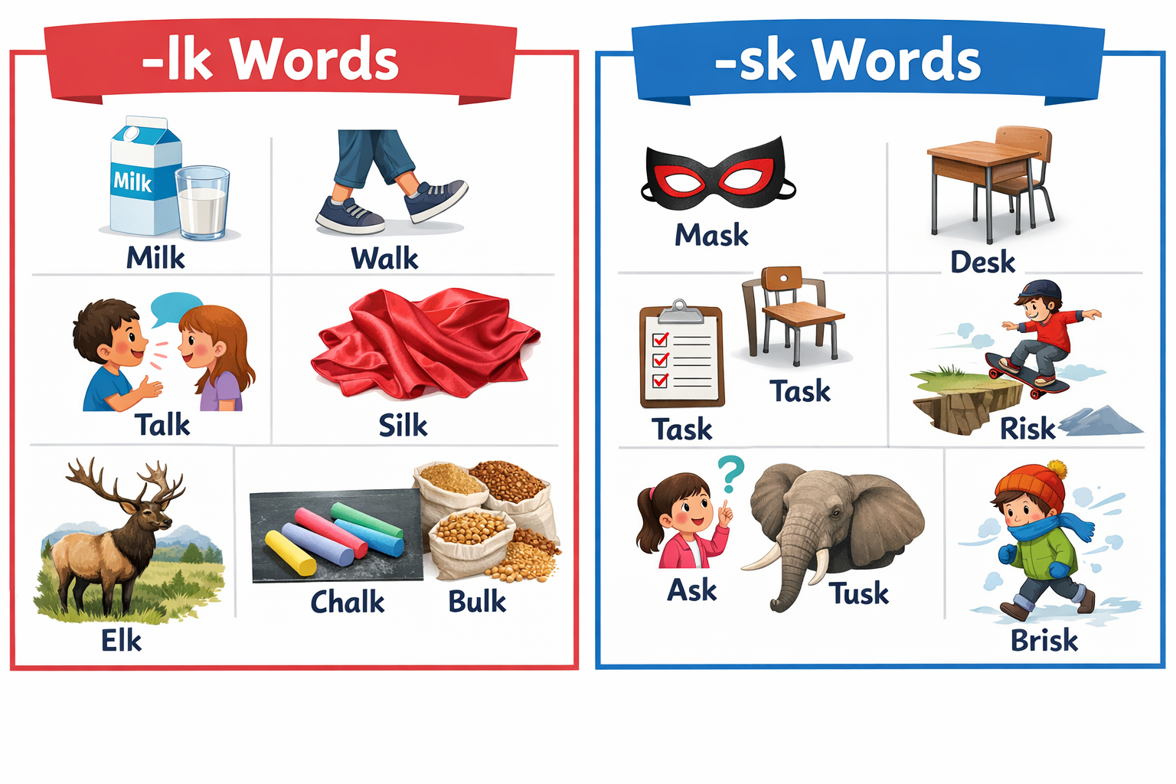
Developing Consonant Blends in English as a Second Language Learner
Jessie Newell
Florida State University Panama City
College of Education
Phonics knowledge is the understanding of the relationship between phonemes (letter sounds) and graphemes (the corresponding letter or letters). Phonics instruction helps students to reach this level of understanding. The overall purpose of this project was to help my student decode CCVC and CVCC words containing consonant blends within a text. This was a targeted intervention, which is important to note, because not all the students needed intervention in this matter. This intervention took place in a classroom with twelve girls and six boys. This is a general education classroom with two ESE students, one student with an IEP plan, one Tier 3 student, and one Tier 2 student.
Introduction
Pre Intervention
Post Intervention
I began by giving the student the CORE Phonics Test. After reviewing her results on the test, I determined that she needed to work on consonant blends in short vowel words. I then created a pretest to verify that this was the targeted need of the student.
Pre Intervention Results
The student experienced significant growth while working on initial consonant sounds. She went from three correct initial consonant blend words to ten, and three correct final consonant blend words to five after our targeted intervention.
.
Participant
The student participating in this survey is a female student in first grade. She is an English Language Learner whose first language is Spanish. Before completing this targeted intervention, I began by giving the student the CORE Phonics Survey and the Qualitative Reading Assessment. I also analyzed her i-Ready results and Star Data. This data helped me to pinpoint the needs of the student.
Intervention
Lesson Sequence
Phonological Awareness: practice recognizing words with consonant blends
Phonics: practice blending together words with consonant blends
Fluency: repeated readings of a decodable text with consonant blends
Encoding: writing words and sentences with consonant blends
Next Steps and Reflection
Some important next steps to work on with this student include determining when a vowel is long versus short. Most of the errors in reading words with the final consonant blends came from her making a short vowel sound long. She can also continue working on decoding words with consonant blends before moving to decoding words with digraphs.
Throughout the process of this targeted intervention, I learned the importance of using images and engaging activities during the lesson to keep students excited about learning.
Research Question
After analyzing the data, I came to the conclusion that the student needed targeted intervention focusing on consonant blends in CVCC and CCVC words.
Does targeted intervention instruction of consonant blends improve the ability to decode CVCC and CCVC words?
References
Honig, B., Diamond, L., & Gutlohn, L. (2018). Teaching Reading Sourcebook (3rd ed.). Arena Press / Academic Therapy Publications.
National Institute of Child Health and Human Development. (2000). Report of the National Reading Panel: Teaching children to read: An evidence-based assessment of the scientific research literature on reading and its implications for reading instruction (NIH Publication No. 00-4769). U.S. Government Printing Office.

