Slide 1



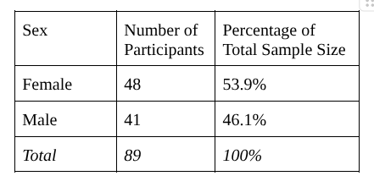
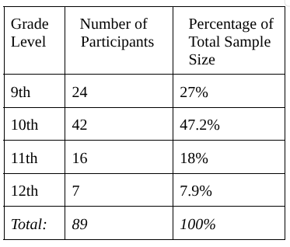
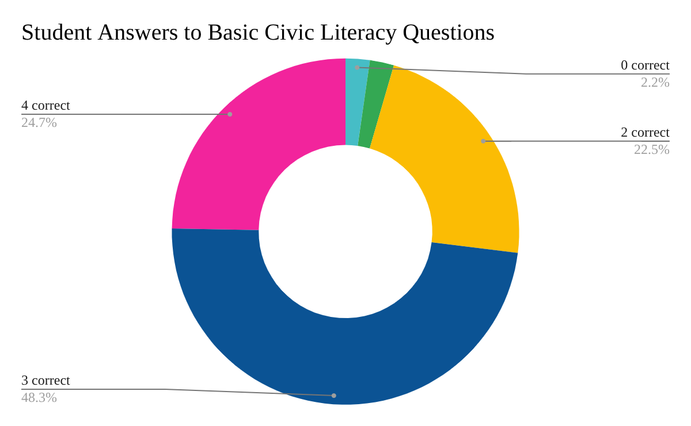
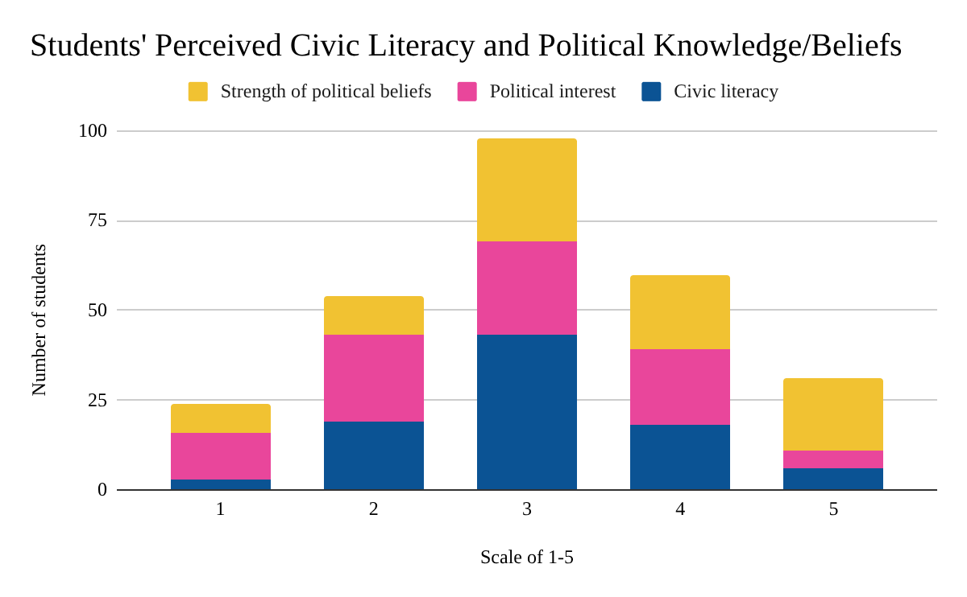
Civic Literacy and Political Interest, Knowledge, and Involvement
For more information, contact:
Hollie Kim
North Bay Haven Charter Academy
(804) 585-5672
xkimh1@bayhaven.org
Hollie Kim
North Bay Haven Charter Academy, Panama City, FL
Abstract
Objective: The objective of this study is to fill the gap in existing research and find the correlation between students’ civic literacy and political interest, knowledge, and involvement.
Methods: A survey using mixed methodology was given to students; to evaluate civic literacy; report political interest, knowledge, and invovlement; and collect demographic information.
Results: There was correlation between civic literacy and students’ political interests and knowledge, as well as their beliefs.
Below is a graph representing student answers to basic civic literacy questions given in the survey. 78.7% of students who took the survey reported taking a civic literacy class, however, only 48.3% of students were able to answer all four questions correctly.
Discussion of Factors
Demographic Information
Although the survey included a disproportionate number of students in tenth grade and a slightly higher number of female students over male students neither one of these variables was heavily considered for analysis according to the original research inquiry.
Civic Literacy
The survey showed that a majority of students reported a 3 on a 1-5 scale when asked to report their self-perceived civic literacy, and much fewer students reported 4s and 5s, despite 78.7% of students reporting taking a civic literacy class.
Political Interest, Knowledge, and Students’ Beliefs
The survey showed that for both political knowledge and how strong their political beliefs are, a majority of students reported a 3 on a 1-5 scale. The results showed a correlation between these factors and civic literacy as shown by the data. Students who reported lower civic literacy were far more likely to report less political knowledge and weaker political opinions compared to their peers who reported higher civic literacy.
Objectives
Evaluate civic literacy among high school students
Determine whether students’ political interests are related to their civic literacy
Limitations
Small sample size (89 participants)
Disproportionate participants in certain grades
Conclusions
Students who reported higher civic literacy also reported more political knowledge and stronger political beliefs.
Implications
This survey can be used as a basis for future research with a larger group of students in diverse areas.
RESULTS
Below is a graph showing the results of the survey. When comparing students’ self-reported civic literacy and political knowledge/beliefs, it can be seen that there is a correlation between the three factors considered..

