Slide 1

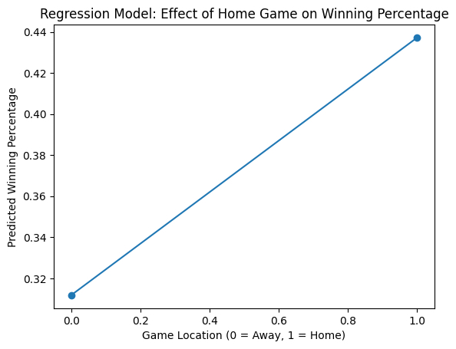
The Effects of Home Field Advantage in Sports
Alex Bashkinov
The Collegiate School at Florida State University Panama City
Abstract
This study uses publicly available game statistics from professional sports leagues. The data includes sixty observations of team performance. The independent variable is game location, coded as 0 for away games and 1 for home games. The dependent variable is team winning percentage.
A linear regression model was used to determine whether game location significantly predicts winning percentage. The regression equation used in this study is:
Win % = 0.3118 + 0.1255(Home)
This model estimates how much winning percentage changes when a team plays at home.
Participants:
This study does not use human participants. Instead, the data comes from sixty recorded games from professional sports leagues. All data was collected from publicly available sports statistics.
The results support the idea that home field advantage has a measurable impact on team performance. The regression model shows that playing at home increases predicted winning percentage by about twelve percent.
One possible explanation is crowd support, which can increase player motivation and confidence. Familiarity with the stadium environment may also give home teams an advantage. Travel fatigue may also affect away teams.
Although the model shows a significant relationship, the R² value of 0.123 suggests that other factors also influence game outcomes, such as team skill level, injuries, or coaching strategies.
Methods
Discussion
Home field advantage is a widely discussed concept in sports that suggests teams perform better when they play at their home venue rather than away. This research focuses on understanding whether home field advantage truly has a measurable impact on team performance in major professional sports leagues. The central question this study addresses is whether teams win more often and perform better statistically when playing at home compared to playing away. Previous research has shown that factors such as crowd support, familiarity with the playing environment, reduced travel, and possible referee bias may all contribute to this advantage. While many studies support the existence of home field advantage, some focus on only one sport or use older data, leaving room for further comparison using recent and consistent data. The goal of this research is to examine home field advantage across multiple sports leagues in a simple and organized way. This study is important because game location can influence coaching strategies, athlete preparation, and sports predictions. To collect data, publicly available game statistics from recent seasons will be gathered from official league websites. These records will be used to compare home and away wins as well as scoring differences. It is expected that the findings will show teams perform better at home, which would support existing research and help explain why home field advantage continues to play a significant role in sports outcomes.
Home field advantage is a common concept in sports that suggests teams perform better when playing in their own stadium. Many studies show that teams often win more games at home compared to when they travel. Researchers believe this advantage may come from several factors including fan support, familiarity with the playing environment, and the lack of travel fatigue.
Although many studies support the idea of home field advantage, the strength of the effect can vary depending on the sport and the data used. Some studies only analyze one sport or use older data. Because of this, it is useful to examine the relationship between game location and team performance using statistical methods.
This study uses regression analysis to test whether playing at home significantly increases a team’s winning percentage.
Conclusions
Introduction
This study found evidence that home field advantage has a statistically significant effect on winning percentage. Teams playing at home are predicted to win about twelve percent more often than when playing away.
These findings support previous research showing that game location can influence performance. Future research could include larger datasets, additional sports leagues, or more variables such as team strength or travel distance. Understanding home field advantage can help coaches, analysts, and sports organizations better understand game outcomes and performance trends.
The regression results show a positive relationship between playing at home and winning percentage.
Key findings from the regression analysis include:
Observations: 60
R²: 0.123
F Statistic: 8.12
Significance F: 0.00605
The coefficient for the home variable is 0.1255, which suggests that playing at home increases predicted winning percentage by about 12.5 percentage points.
The p value for the home variable is 0.006, which indicates the result is statistically significant.
Results
Hypotheses
References
Retrieved from SB Nation: https://www.sbnation.com/2011/1/19/1940438/home-field-advantage-sports-stats-data
Jamieson, J. (2010). The Home Field Advantage in Athletics: A Meta-Analysis. Journal of Applied Social Psychology 40 (7), 1819-1840.
Pinger, N. (2015, June 15). Home Field Advantage: The Facts and the Fiction. Retrieved from Chicago Booth Review: https://www.chicagobooth.edu/review/home-field-advantage-facts-and-fiction
Sporting Bounce. (2025, March 24). The Science of Home Advantage in Sports. Retrieved from Sporting Bounce: https://www.sportingbounce.com/blog/the-science-of-home-advantage-in-sports
H0 (Null Hypothesis):
Playing at home does not affect a team’s winning percentage.
H1 (Alternative Hypothesis):
Playing at home increases a team’s winning percentage.

