Slide 1

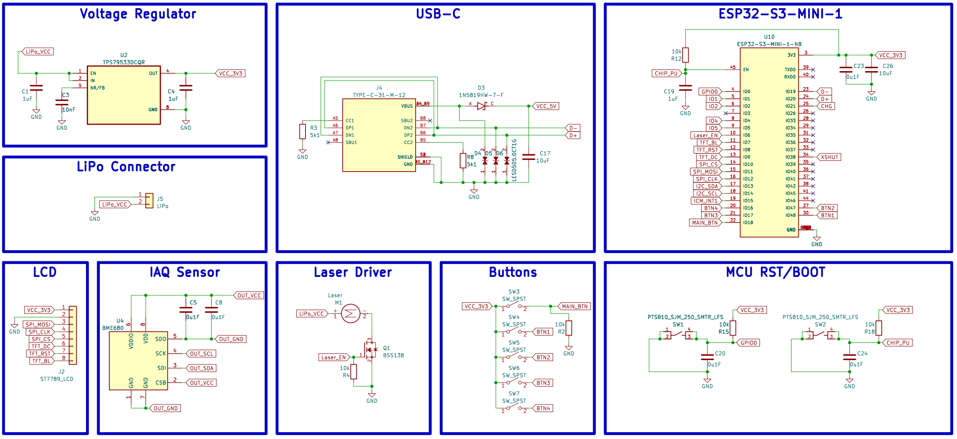
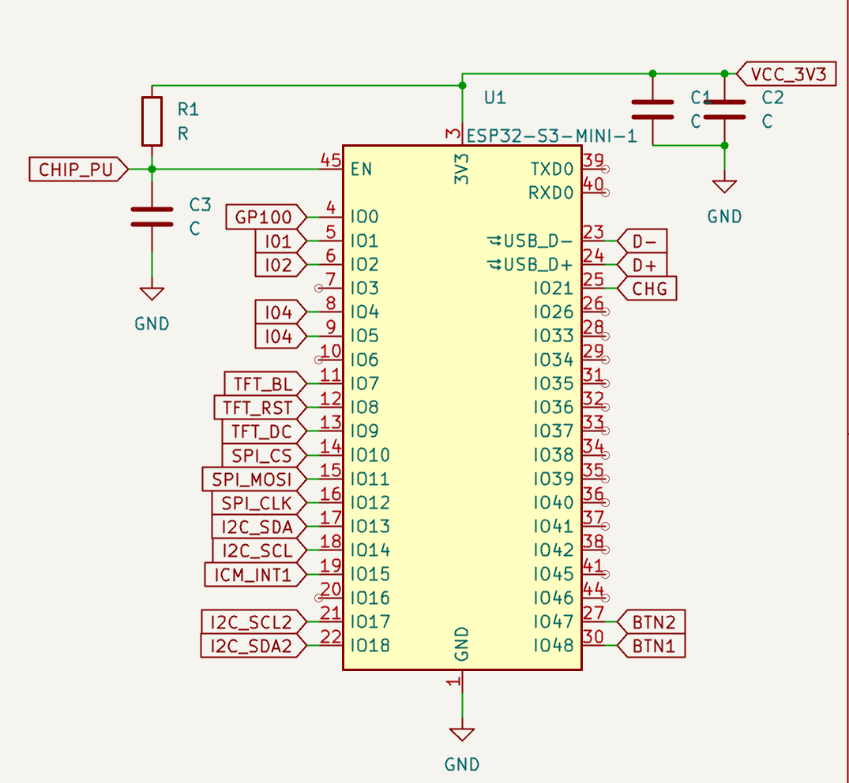
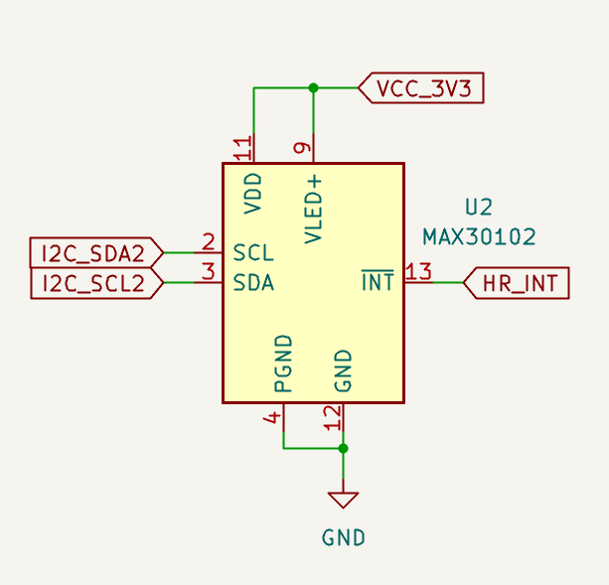
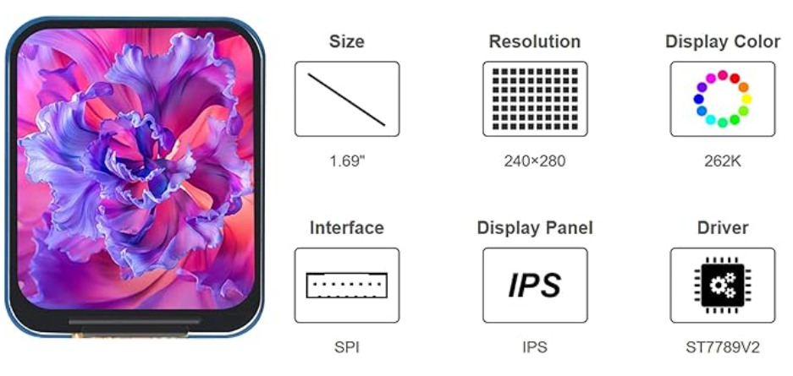
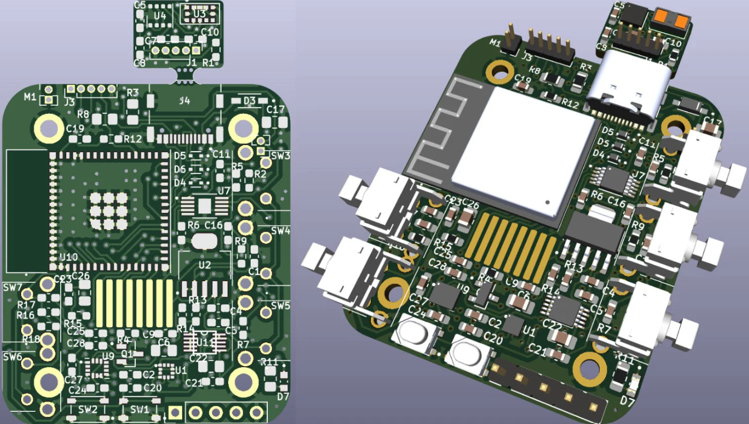
Open-Source Health Monitoring Watch Design as an Accessible and Modifiable Alternative to Proprietary Wearables
Krieg Conrad
Florida State University Panama City
Abstract
Design
Conclusions/ Proposals
While wearable health and activity monitoring devices are increasingly prevalent, many commercial implementations rely on proprietary and closed-source software and remain financially inaccessible to a broad user base. This project presents the design of a low-cost, open-source wearable platform that provides a modifiable and transparent foundation for wearable sensing research and educational applications.
A custom printed circuit board (PCB) has been designed integrating a microcontroller, inertial measurement unit (IMU), optical heart rate sensor, display, and battery management circuitry to support portable operation and charging. Embedded firmware was developed to enable sensor data acquisition, basic signal processing, and user interaction while emphasizing modularity and simple fabrication for future modification by the broader community.
This work focuses on the development of an open-source wearable platform intended to support future validation studies of health and activity monitoring systems. The system architecture and design approach provide a foundation for subsequent experimental evaluation. Additionally, a potential framework for a future research study is discussed, outlining how the device may be implemented in controlled human-subject testing to assess wearable health monitoring capabilities, including heart rate and step detection, under varying activity conditions.
This work demonstrates the design and development of a low-cost, open-source wearable platform intended to improve accessibility and transparency in health monitoring technologies. By integrating widely available components into a modular and reproducible system architecture, this project establishes a foundation for both educational use and future research in wearable sensing. The platform addresses key limitations identified in existing commercial devices, including cost barriers and restricted system transparency, while enabling user-driven modification and iterative optimization.
The proposed system highlights the potential of open-source engineering approaches to expand access to wearable health technologies and support broader public health impact. By reducing financial and technical barriers, such platforms may enable increased adoption across diverse populations, allowing more individuals to benefit from continuous health monitoring and behavior-driven feedback.
As a next step, a structured experimental framework has been proposed to evaluate device performance in controlled human-subject studies. This includes the development of standardized testing procedures for heart rate monitoring and step detection under varying activity conditions, as well as the incorporation of interrater reliability to ensure consistency of reference measurements. Supporting materials, including participant consent forms and demographic health surveys, have been prepared to facilitate ethical and reproducible data collection.
Future work will focus on implementing this experimental framework to assess system accuracy, reliability, and robustness under real-world conditions. Additionally, the open-source nature of the platform enables further refinement and optimization through community contribution, supporting ongoing development and adaptation for application-specific use cases.
ESP32-S3-MINI-1
Heart Rate Sensor
Image used as reference
Recent engineering literature highlights key trade-offs between open-source and proprietary systems, with open-source platforms improving accessibility, reducing cost, and enabling transparency and user-driven modification [1]–[4]. Open hardware further supports reproducibility and iterative design by providing direct access to system architecture and underlying algorithms [4]. However, these systems require careful validation, as challenges such as increased user expertise and variability in documentation remain, and sensor accuracy must be verified under real-world conditions [4], [5].
Wearable health monitoring devices have demonstrated measurable benefits in increasing physical activity, promoting behavior change, and improving health engagement, particularly among individuals with chronic conditions [6]–[8]. Despite these advantages, adoption remains limited due to cost, accessibility, and restricted system transparency, even among populations with high interest [9].
Open-source approaches provide a pathway to address these barriers by lowering costs and enabling community-driven optimization, thereby expanding access to wearable technologies [2]–[4]. Together, these findings support the development of accessible, open-source wearable platforms to bridge the gap between demonstrated health benefits and real-world public health impact.
Introduction
Methods
The wearable platform was designed using KiCad, an open-source electronic design automation (EDA) software, to support a fully customizable and reproducible hardware architecture. The system is centered around an ESP32-S3 microcontroller, selected for its low power consumption, integrated wireless capabilities, and compatibility with embedded sensor systems.
To ensure relevance and comparability with existing wearable technologies, commercially validated sensing components were selected, including an inertial measurement unit (IMU) and an optical heart rate sensor commonly used in consumer wearable devices. These components were integrated into a custom printed circuit board (PCB) design optimized for compactness and portability. Power is supplied via a single-cell lithium polymer (LiPo) battery with onboard charging and regulation circuitry to support continuous operation.
The PCB was fabricated and assembled through PCBWay to enable rapid prototyping and iteration. A 1.69-inch SPI-based TFT display (240×280 resolution) was incorporated to provide real-time user feedback and interface functionality, selected for its balance between visual clarity, power efficiency, and form factor. System firmware is being developed to enable sensor data acquisition, signal processing, and user interaction.
[1] A. MacCormack, J. Rusnak, and C. Y. Baldwin, “Exploring the structure of complex software designs: An empirical study of open source and proprietary code,” Management Science, vol. 52, no. 7, pp. 1015–1030, 2006.
[2] K. Blind et al., “The impact of open source software and hardware on technological independence, competitiveness and innovation in the EU economy,” European Commission, 2021.
[3] J. M. Pearce, “Economic savings for scientific free and open source technology: A review,” HardwareX, vol. 8, e00139, 2020.
[4] R. Oellermann et al., “Open electronics in science: Towards reproducible and accessible research,” PLOS Biology, vol. 20, no. 10, e3001836, 2022.
[5] S. Canali et al., “Challenges and opportunities in wearable health technology: A critical review,” npj Digital Medicine, vol. 5, no. 1, 2022.
[6] M. Ferguson et al., “Effectiveness of wearable activity trackers in increasing physical activity: Systematic review and meta-analysis,” The Lancet Digital Health, vol. 4, no. 8, pp. e615–e626, 2022.
[7] H. Kang et al., “Wearable devices and behavior change: A systematic review,” Journal of Medical Internet Research, vol. 24, no. 8, e36182, 2022.
[8] Y. Yu et al., “The impact of wearable devices on physical activity in chronic disease populations,” International Journal of Environmental Research and Public Health, vol. 20, no. 3, 2023.
[9] M. Holko et al., “Digital health technology and inequality: Access to wearable devices,” npj Digital Medicine, vol. 5, no. 93, 2022.
References

