Slide 1

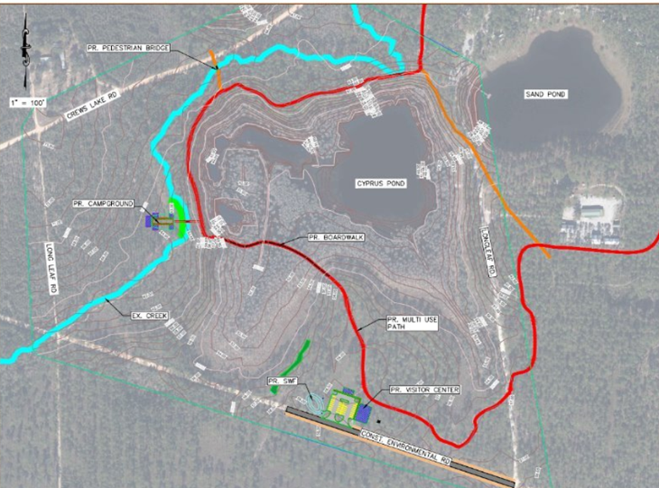
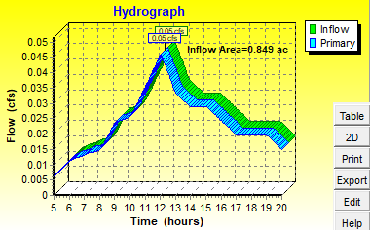
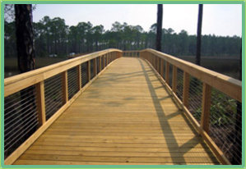
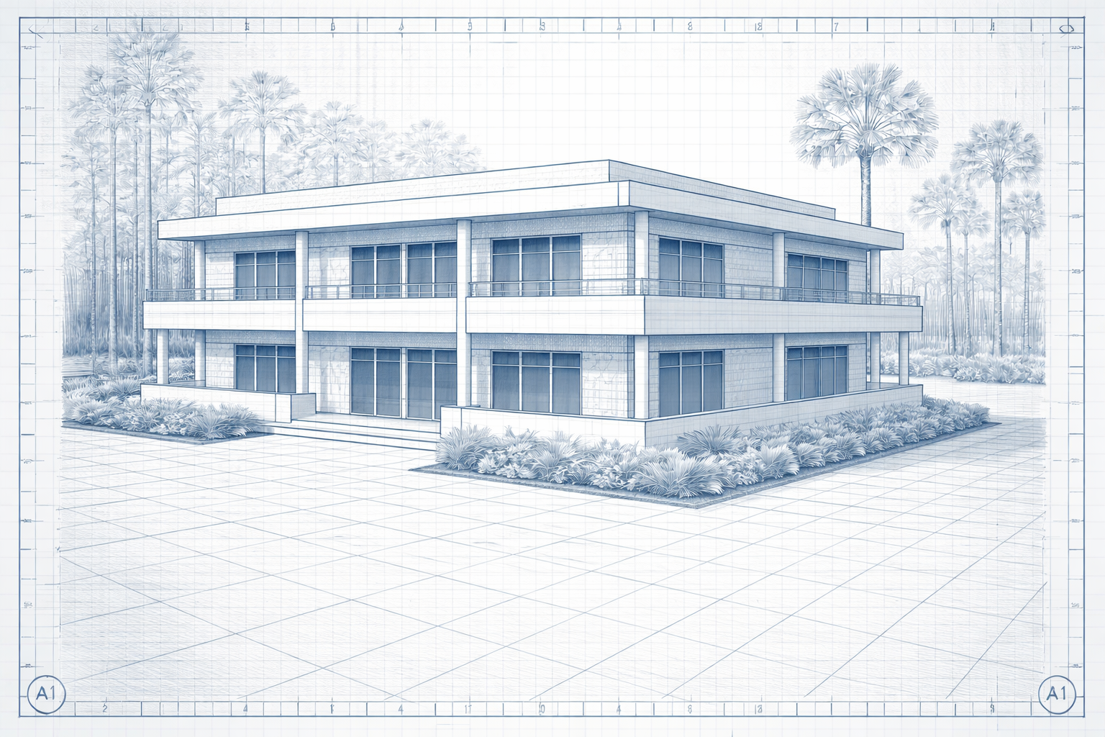
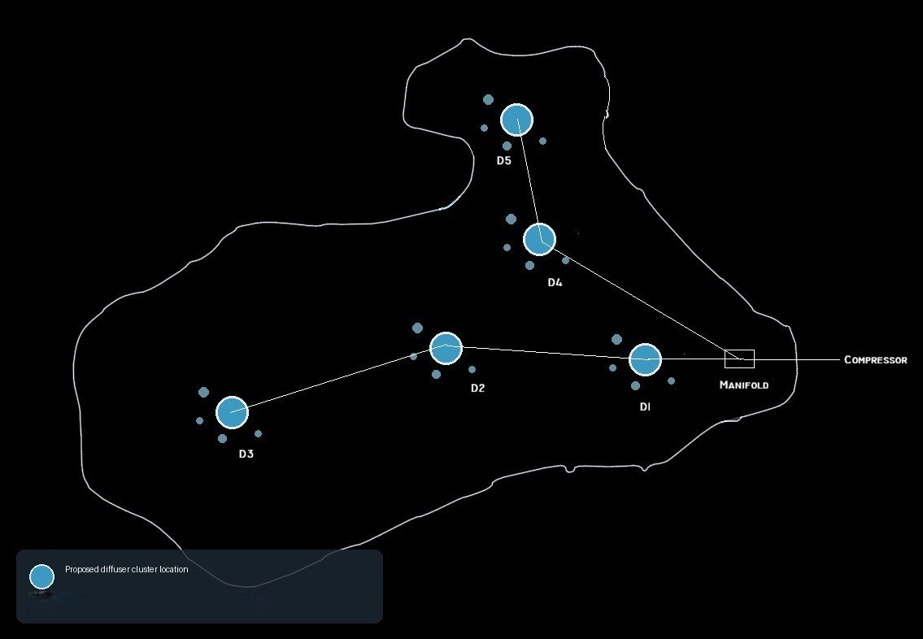
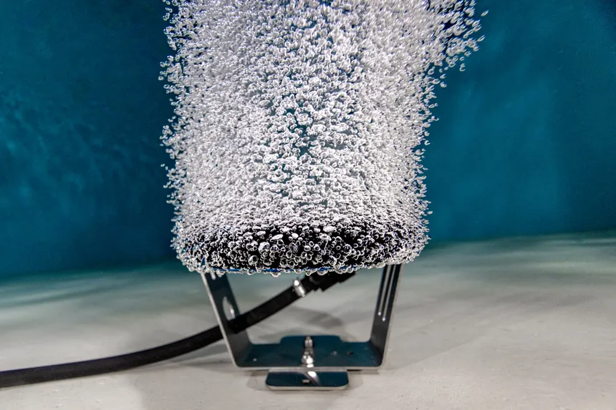
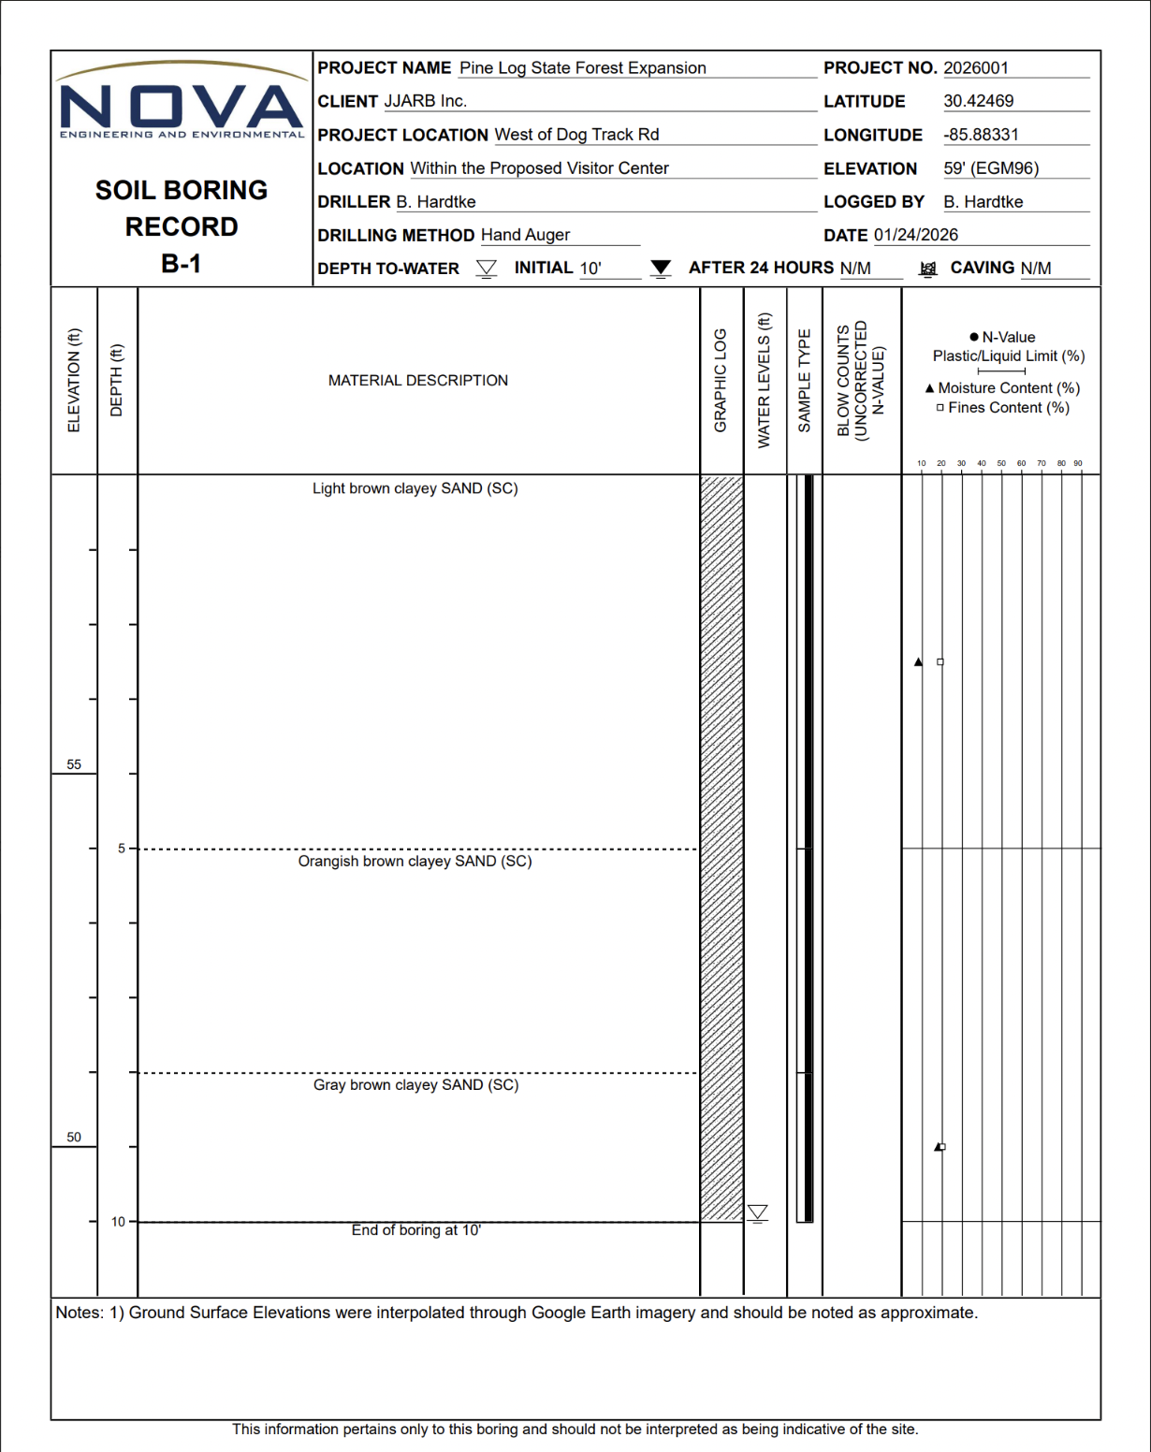
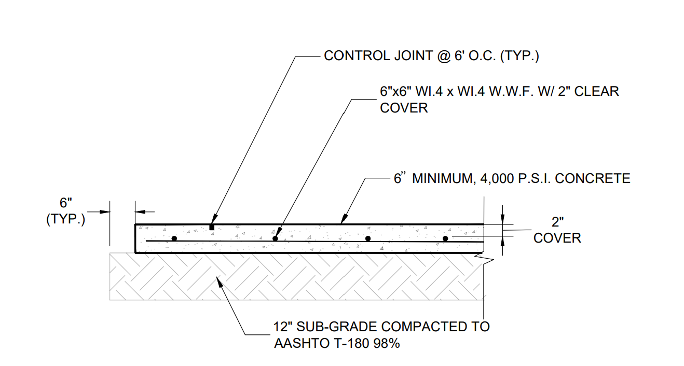
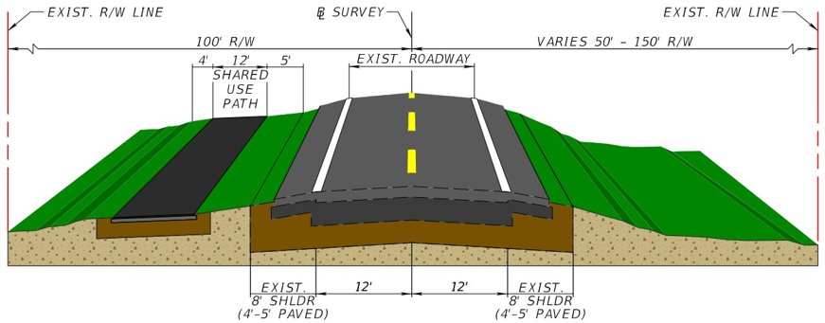
Pine Log State Forest Expansion
Jacob Hernandez, Jared Williams, Addie Cope, Ryan Furniss, Branden Hardtke
Florida State University Panama City
Welcome Center: 80' × 60' two-story reinforced concrete building serving as the primary facility for visitor services
Pavilions: Four 16' × 12' open-air wood-framed structures
Restroom Facility: 24' × 12' concrete building
Boardwalk: 580' timber boardwalk on pile foundations through the Cypress Pond marsh, minimizing site disturbance
Pedestrian Bridges: Three prestressed concrete beam bridges (20', 20', 40') with a 6" deck
Evaluated site drainage and flow paths
Runoff calculations using standardized methods
Stormwater management and treatment system
Dry pond design for required storage volume
Pipe network design with lift station
Project Overview
Structural
Hydraulics
This project involves the expansion and design of a 90-acre site in Ebro, Florida with the goal of improving public accessibility while preserving the natural environment. Emphasis was placed on minimizing environmental impacts, preserving natural function, and creating a balanced design that supports both recreational use and long-term site performance.
Environmental
Traffic Impact Study
Paved Roadway
Pedestrian Facilities
Parking Lot
Signing and Pavement Markings
Diffused Aeration System for Sand Pond
Blower sizing and pipe head loss
Oxygen transfer rate and efficiency of transfer
Natural Vegetative Buffer
Lab tests of Dissolved Oxygen, Nitrates and Ammonia
Transportation
Geotechnical
Multiple Hand Auger Borings
Lab tests ran to ASTM Standards: Modified Proctor, LBR, Moisture Content, Fines Content, & Organic Content
Soil Classification
Determined a permeability rate for stormwater design
Calculated Ultimate Bearing Capacity
Acknowledgements
Special thanks to our mentors:
Blake Furbee, P.E. Sammy Purd'homme, E.I. Dillon Fuder, E.I Heather Remick, P.E.
Dexter Gortemoller, P.E. Shawn Justice, P.E. Chris Alessio, E.I.

