Slide 1

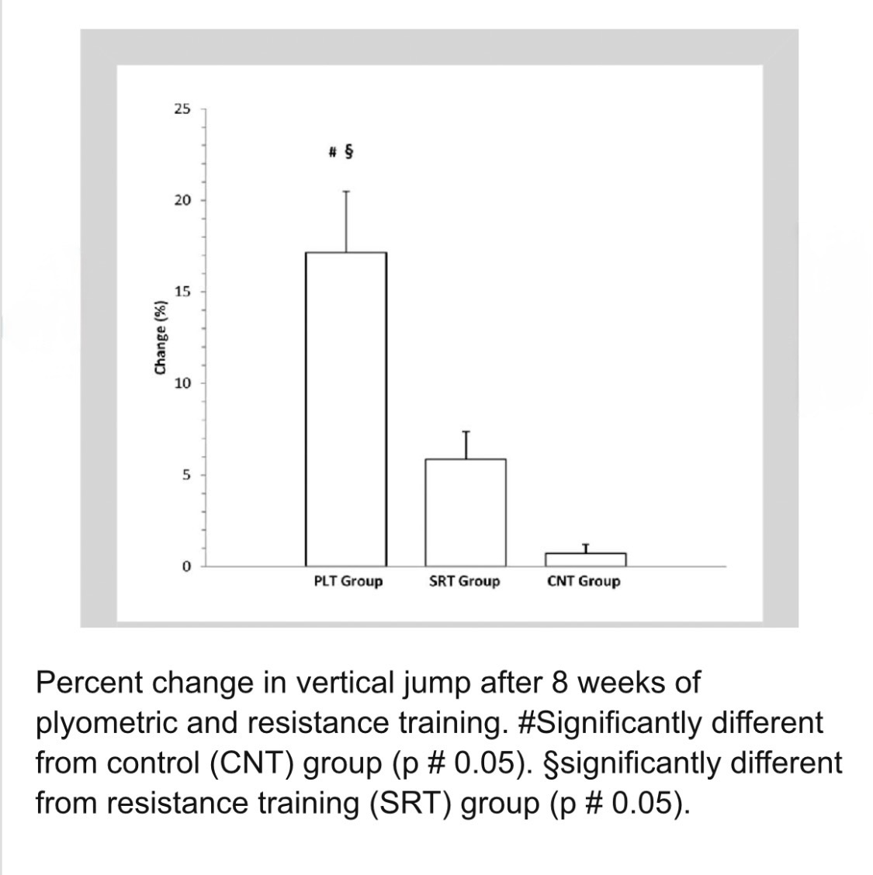

The Correlation Between Plyometrics and Athletic Performance
Nicholas Brantley
The Collegiate School at Florida State University Panama City
Abstract
Methods
Literature Review
In pursuit of peak athletic performance, particularly in high-velocity sports like track and field, athletes may be inherently exposed to significant risk of injury. Understanding sprint biomechanics and optimizing running technique can reduce injury risk and enhance overall performance. This research addresses the question of what roles sprinting form and biomechanics play in reducing muscle related injuries. I chose plyometrics because it is an effective type of exercising athletes use to improve and boost performance. A plyo routine affects sprint biomechanics by activating fast twitch muscle fibers, strengthening ankle stiffness, and reducing ground contact time. The connection between injury prevention and athletic performance is plyometrics. In this study, Percent changes in vertical jumps after plyometrics after 8 weeks were measured. This research can be used to show coaches the effects of plyometrics and implement it into school and gym workouts to reduce injury risks and increase the performance of all athletes.
For the literature component of this research project, peer-reviewed studies examining the relationship between plyometric training and athletic performance were identified through academic databases such as Google Scholar and sports science journals. Keywords including plyometric training, sprint performance, biomechanics, and athletic injury prevention were used to locate relevant sources. Selected studies focused on sprint performance, leg power development, biomechanical efficiency, and injury trends in athletes. These articles were chosen because they provide empirical data on how plyometric exercises influence speed, power output, and overall athletic performance. The findings from these sources were analyzed and compared to identify common trends, which were then used to support and contextualize the research project’s investigation into the correlation between plyometric training and improvements in athletic performance.
This literature review was primarily focused on the pursuit of peak athletic performance, particularly in high-velocity sports like track and field (sprinting and jumping events),inherently exposes athletes a significant risk of injury. The literature reviewed consistently supports a positive relationship between plyometric training and improvements in athletic performance. Studies such as those by Young et al. (1995) and Yamashita et al. (2019) demonstrate that plyometric exercises significantly enhance leg power, explosive strength, and sprint speed. Research also highlights the biomechanical benefits of plyometric training, suggesting that improved neuromuscular coordination and force production contribute to better performance outcomes (Khan et al., 2025). Additionally, other studies emphasize the importance of training load and injury monitoring when implementing plyometric programs in athletic populations (Edouard et al., 2022; López-Guajardo et al., 2023). Collectively, these findings align with the goals of this research project by supporting the hypothesis that structured plyometric training can positively influence key athletic performance metrics such as speed, power, overall efficiency in movement and help can help us understand our research question, "What is the correlation of plyometrics and athletic performance".
Conclusions
Introduction
Results
Plyometric training has the dual advantage of boosting explosive power while improving the neuromuscular control and tissue capacity needed to withstand high-speed strains. Finally, sports biomechanics offers the diagnostic tools necessary to identify and fix individual movement flaws that often lead to chronic muscle injuries. Moving forward, the best injury prevention methods must be tailored and periodic, consistently adjusting these three principles to meet the athlete's specific needs and competition stages, ensuring peak performance and long-term health.
Injury prevention for track and field athletes is complex, requiring an evidence-based, holistic approach. This research clearly shows that three key elements—managing running surfaces, integrating plyometric training, and applying biomechanical analysis—are essential to a successful prevention program. Changing training surfaces helps manage overall load and lower the distinct injury risks related to both hard and soft grounds. The significance of the research is to seek injury prevention and the risk factors athletes face and how to decrease those risks and improve performance levels. To research this, you must have an understanding of the biomechanical analysis because it’s pivotal for understanding and mitigating the risk of muscle-related injuries, particularly the highly recurrent hamstring and thigh muscle injuries common in track disciplines.
The bar graph shows that athletes who completed plyometric training (PLT group) had the largest increase in vertical jump performance compared with resistance training or control groups.
Vertical jump height is a standard measurement for explosive lower-body power, meaning improvements directly reflect increased power output and neuromuscular efficiency.
Studies consistently show plyometric programs improve jump height and sprint performance, both indicators of explosive athletic ability.
References
Research question
My research question is "What is the correlation between plyometrics and athletic performance?”

