Slide 1

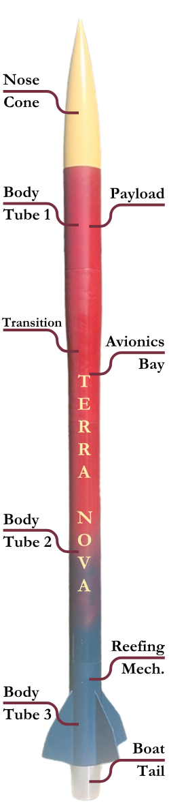
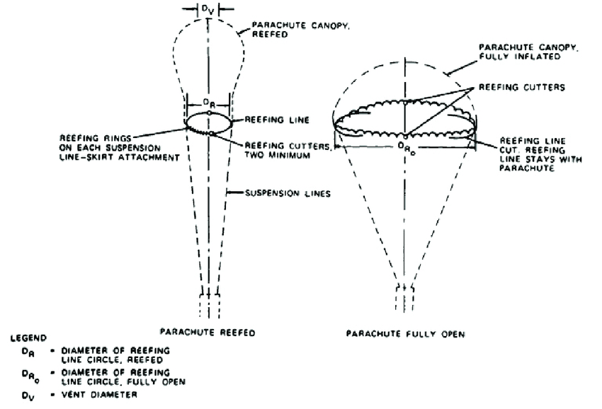
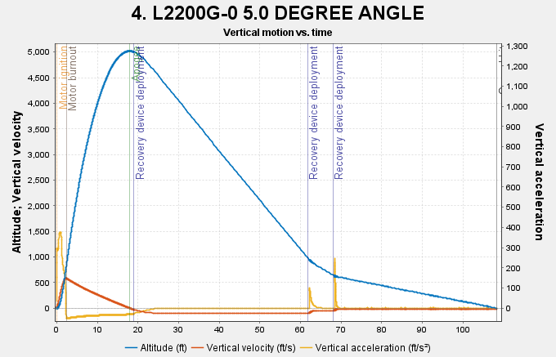
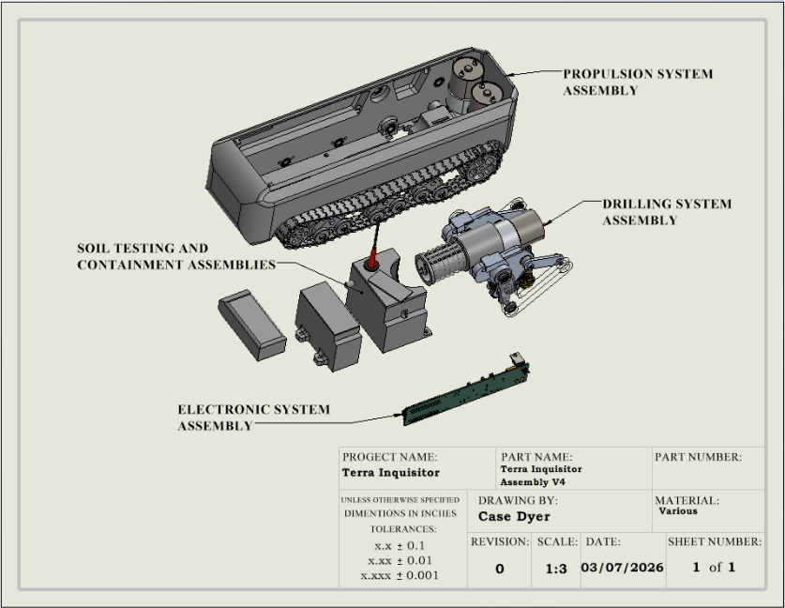
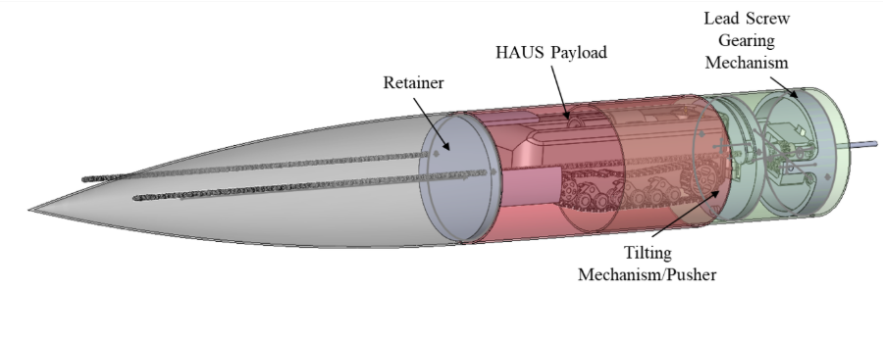

FSU PC NASA USLI Team
The Terra Nova Project
Krieg Conrad, Jonathan Serbest, Case Dyer, Austin Zaal, Matthew Wilson, Jayden Duarte
Florida State University Panama City
Abstract
Launch Vehicle
Recovery
The mission of the Terra Nova Project is to design and manufacture a high-powered rocket able to successfully carry and deploy the HAUS (Habitat for Agricultural Utilization Study) payload, the Terra Inquisitor. The Terra Inquisitor will be designed and fabricated to collect and test a sample of soil for pH within 15 minutes of landing. The design of the recovery system is to safely reach ground level within 80 seconds of apogee. The safety of the landing is based on all individual rocket sections sustaining no more than 65 ft-lb of energy without causing irreparable damage. The design and manufacturing of all recovery system components shall meet all specified safety criteria and NASA launch rules and guidelines. Inconel bulkheads will be used to absorb forces imparted on the recovery system and manufactured using the new form of additive manufacturing, 3D metal printing.
The Terra Nova or New Earth launch vehicle is a reusable high-powered rocket designed to meet the mission requirements specified in the NASA USLI handbook.
Major vehicle components include:
•Nose cone housing the payload system
•Custom Fiberglass Transitional Airframe and Aluminum Boat-tail to optimize vehicle drag • Fiberglass body tubes and couplers forming the airframe
•Custom high-strength 3D printed Inconel 718 Bulkheads to ensure strength as well as incorporate innovative technology. • An avionics bay containing flight computers and deployment electronics • HAUS section containing the Mechanical Separation System and Terra Inquisitor • Utilizes an L2200G motor
The launch vehicle uses a two-stage recovery system designed to safely return the rocket and payload to the ground.
Key features of the recovery system include: • A drogue parachute deployed at apogee to stabilize the rocket during initial descent • A main parachute deployed at a lower altitude to slow the rocket before landing • A reefing system designed to partially restrict the main parachute during early deployment to reduce shock loads • A recovery sequence designed to ensure the rocket lands within the 2,500 ft landing radius requirement | Design targets for the system include: • Landing within 90 seconds after apogee • Landing with less than 75 ft-lbs of kinetic energy • Achieving bonus performance targets of less than 65 ft-lbs landing energy
Flight Data
HAUS Payload
Separation System
The Terra Inquisitor or Earth Searcher design features: • Deploys only after landing to meet HAUS mission and safety requirements • Housed within the Mechanical Separation System • Steel reinforced 3D printed chassis to ensure structural integrity • Dual-track propulsion (Pololu 37D, 4741) enables post-landing mobility • Integrated drilling and soil collection systems designed for repeatable operation Implements a four-bar linkage system to control the drilling system • Utilizes a custom PCB for all sub-system power and control interface.
Separation system controls nose cone removal and payload positioning. This is done by utilizing a stepper motor-driven lead screw that converts rotational force into linear deployment motion of nosecone.
Retainer and pusher system:
Ejects nose cone
Maintains controlled payload retention
Spring-loaded tilting mechanism:
Deploys after constrained removal
Provides clearance for payload exit
• NEMA 17 motor with geared system increases torque and synchronization • Worm gears prevent back-driving, securing system during flight • Designed for controlled, repeatable, and reliable deployment under load
Flight and Recovery Performance Predictions
Apogee | Velocity off Rod | Landing Velocity | Descent Time | Heaviest Section | MAX Impact Energy
4986 ft | 77.2 ft/s | 15.6 ft/s | 80 s | 16.125 lbs | 60.93 ft- lbs

