Slide 1
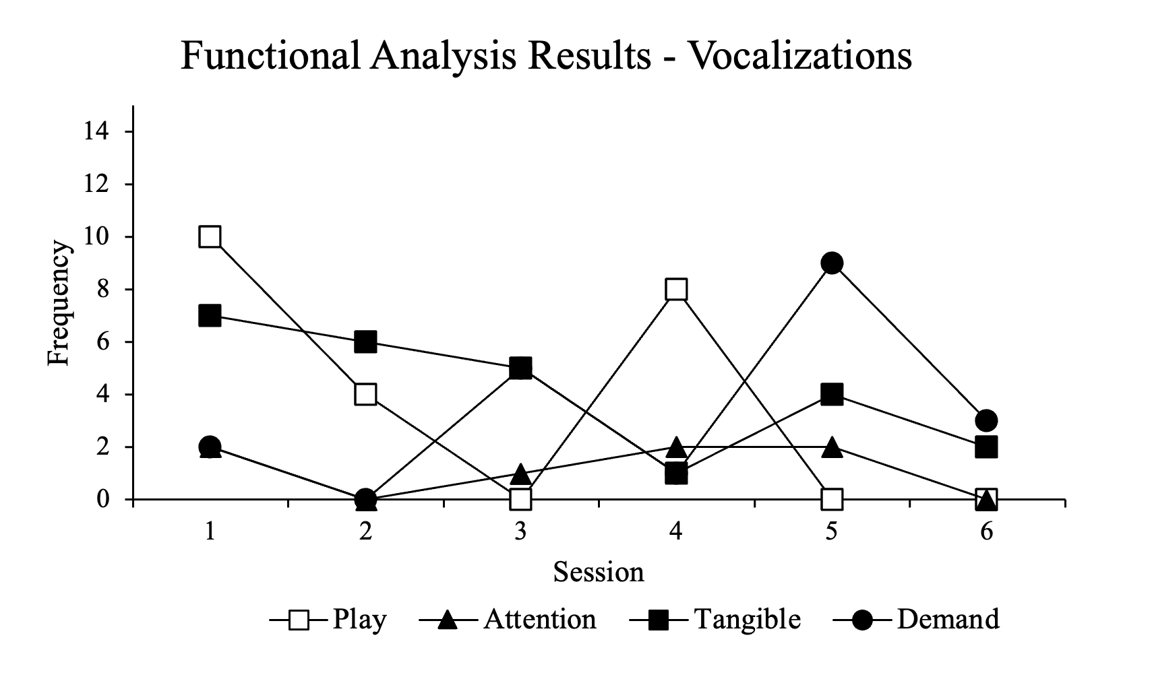
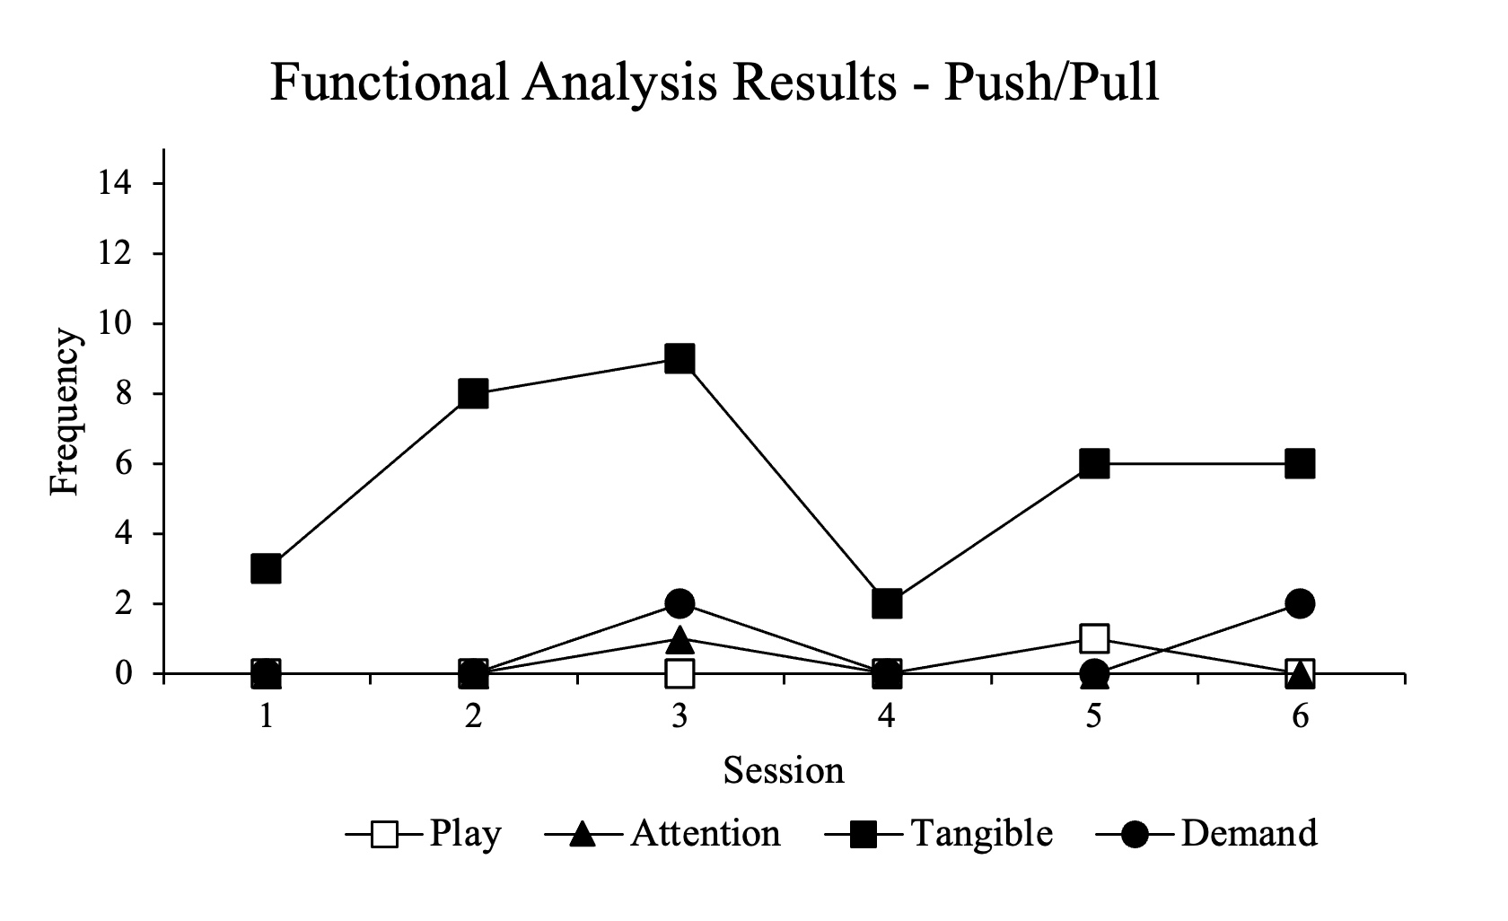

A Functional Analysis of Communication Behavior
Florida State University, Panama City
Lydia Wilkinson, B.S., RBT, Leah Koehler, PhD, BCBA-D and Zoe Bowden, M.A., BCBA
Introduction
Results
A mand is defined as a verbal operant in which the response is reinforced by a characteristic consequence (Skinner, 1957)
Teaching communication behavior may aid in preventing occurrences of problem behavior (Ala’i Rosales et al., 2018)
Previous research has utilized functional analysis methodology to determine the function of problem behaviors (Iwata et al, 1994)
The purpose of the present study is to replicate and extend functional analysis procedures described by Plavnick and Ferreri (2013) to examine multiple topographies of communication and the motivating operations under which they occur in young children with autism spectrum disorder.
Participant is a four-year-old boy diagnosed with Autism Spectrum Disorder (ASD) and attends 25 hours of ABA therapy a week
Client has a limited vocal verbal repertoire and established nonverbal communication. His clinical team recently introduced Picture Exchange Communication System (PECS)
Frequency of responses of each target behavior were recorded for each condition and each session.
Results indicated that the reach/touch and push/pull behaviors occurred more during the tangible condition, and vocalizations occurred most across tangible and play conditions. Clinicians will often provide a reminder about his rules to redirect, which has served as an effective method of preventing behaviors.
Vocalizations that were recorded were sounds (rather than words) and were seen consistently across all conditions, whereas the other target behaviors were seen most frequently in the tangible condition.
Discussion
Due to the functional relation being demonstrated across the reach/touch and push/pull behaviors, future interventions should focus on pairing those behaviors with more functional behaviors, such as single word manding.
There was no functional relation demonstrated for vocalizations. This indicates that the participant engages in vocals across a variety of settings and functions.
Recommended intervention includes a function-based mand training program in which clinicians utilize tangibles to evoke communications; clinicians may restrict highly preferred reinforcers (such as those utilized in this study) to have the participant mand for them.
Limitations:
Clinicians also observed the participant engaging in vocal stereotypy during all conditions, which was excluded from the operational definition for vocalizations.
This is only an assessment. Treatment is being designed but has not been included as part of this study. This assessment also only examines mands; it does not assess any other verbal operants.
This assessment may not accurately reflect environmental contingencies due to the conditions being in a manipulated environment
Methods
A paired-stimulus preference assessment will identify preferred stimuli for experimental conditions.
An indirect assessment (via interview with caregivers and clinicians) and shortened pilot conditions will identify communication topographies that will function as the dependent variable
Data (as well as IOA and an integrity checklist for 20% of trials) will be taken from an adjacent room
Using a multielement design, communication responses will be assessed across play (control), attention, tangible, and demand conditions to identify differential responding associated with specific environmental contingencies:
Play
They receive noncontingent access to preferred items
Physical or verbal attention is provided continuously, contingent on target response not occurring in the last five seconds
Attention
They receive access to low preference items
Clinician stands 1-3 feet away, engaging with something else
Clinician offers verbal or physical attention contingent on target behavior
Tangible
Highly preferred items are visible, but not available (i.e., high up on a shelf)
Clinician will guide the child in, tell them they can have the item and step away
Clinician will help the child get access to the tangible contingent on target behavior
Child then receives five seconds with tangible, or access to a piece of edible
Demand
The clinician will present demands continuously, utilizing social praise and least-to-most prompting to aid in responding
Clinician will remove the demand for 20 seconds and turn away contingent on target behavior
Figure 1: The figure above depicts the frequency of vocalizations that the participant engaged in across each condition.
References
  Ala’i-Rosales, S., Cihon, J. H., Currier, T. D. R., Ferguson, J. L., Leaf, J. B., Leaf, R., McEachin, J., & Weinkauf, S. M. (2018, September 20). The big four: Functional assessment research informs preventative behavior analysis. Behavior analysis in practice.
  Iwata, B.A., Dorsey, M.F., Slifer, K.J., Bauman, K.E. and Richman, G.S. (1994). Toward a functional analysis of self-injury. Journal of Applied Behavior Analysis, 27: 197-209.
  Plavnick, J. B., & Ferreri, S. J. (2011). Establishing verbal repertoires in children with autism using function-based video modeling. Journal of Applied Behavior Analysis, 44(4), 747–766. (This is the one my study is based most on)
  Lerman, D. C., Parten, M., Addison, L. R., Vorndran, C. M., Volkert, V. M., & Kodak, T. (2005). A methodology for assessing the functions of emerging speech in children with developmental disabilities. Journal of Applied Behavior Analysis, 38, 303–316.
  Sigafoos, Jeff & Woodyatt, Gail & Keen, Deb & Tait, Kathleen & Tucker, Madonna & Pennell, Donna & Pittendreigh, Nicole. (2000). Identifying Potential Communicative Acts in Children with Developmental and Physical Disabilities. Communication Disorders Quarterly. 21. 10.1177/152574010002100202.
  Skinner, B. F. (1957). Verbal behavior. New York: Appleton-Century-Crofts.
Figure 2: The figure above depicts the frequency of push/pull responses that the participant engaged in across each condition.

